Slide 1
Rock vs Mine Machine Learning Model Proposal

Slide 2
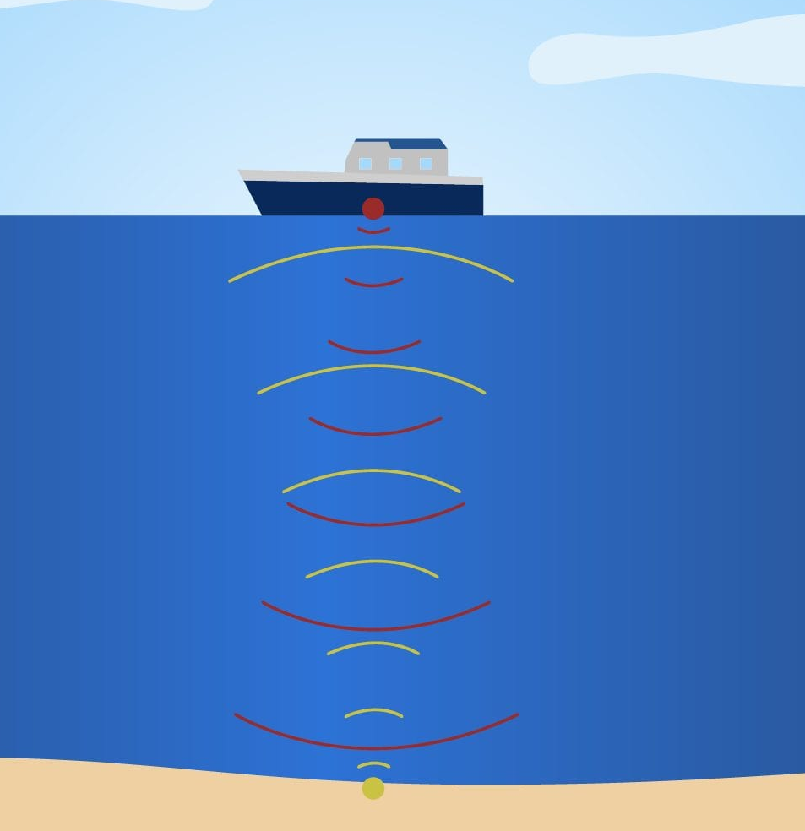
SONAR Classification Deep Ocean Model
Dive into the depths of the ocean with my cutting-edge SONAR-based machine learning model designed to discern between rocks and mines beneath the waves. Harnessing the power of sophisticated algorithms, this model analyzes intricate SONAR data to make real-time predictions, offering a technological leap in underwater object classification. Whether you're navigating the unseen world of the ocean floor for research or ensuring safe maritime operations, my model promises accurate identification, paving the way for enhanced underwater exploration and security.

Slide 3
Project Workflow
Sonar Data
Data
PreProcessing
Training and testing the reiceved data
Logistic Regression Model
New data
Trained Logistic Regression Model
Predicted Outcome

Slide 4

Logistic Regression Model
Logistic regression is a supervised machine learning algorithm that accomplishes binary classification tasks by predicting the probability of an outcome, event, or observation. The model delivers a binary or dichotomous outcome limited to two possible outcomes: yes/no, 0/1, or true/false.
Logistic regression is commonly used for prediction and classification problems. Some of these use cases include: Fraud detection: Logistic regression models can help teams identify data anomalies, which are predictive of fraud.

